Slide 1
STM-32 , HAL, STMCubeMx
PWM RGB LED & UART Command Demo

Slide 2
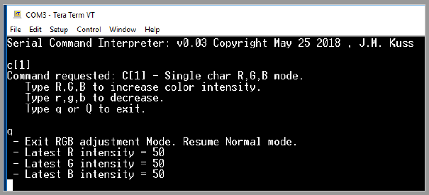
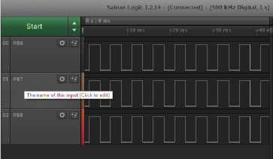
System power up
Command interpreter put into RGB PWM Duty Cycle Adjustment Mode:
R,G,B, each at PWM 200 Hz, 50% on/off duty cycle

Slide 3
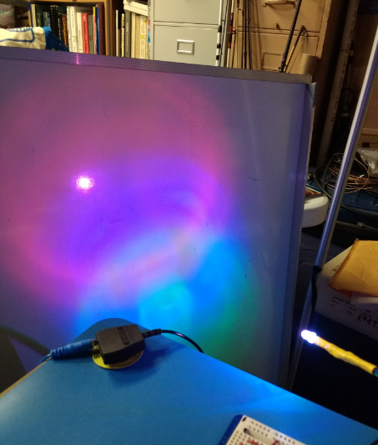
Driving LED R,G,B @ 50,50,50
LED itself appears white but it projects 3 colors
Notes:
Kingbright LED WP154A4SEJ3VBDZGC/CA. Driving Apx 20 mA each channel 50% duty cycle

Slide 4
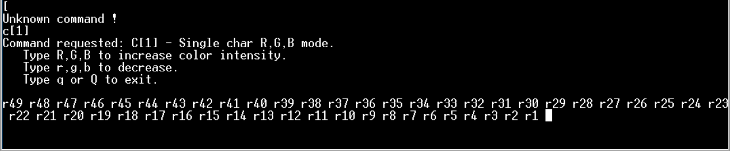
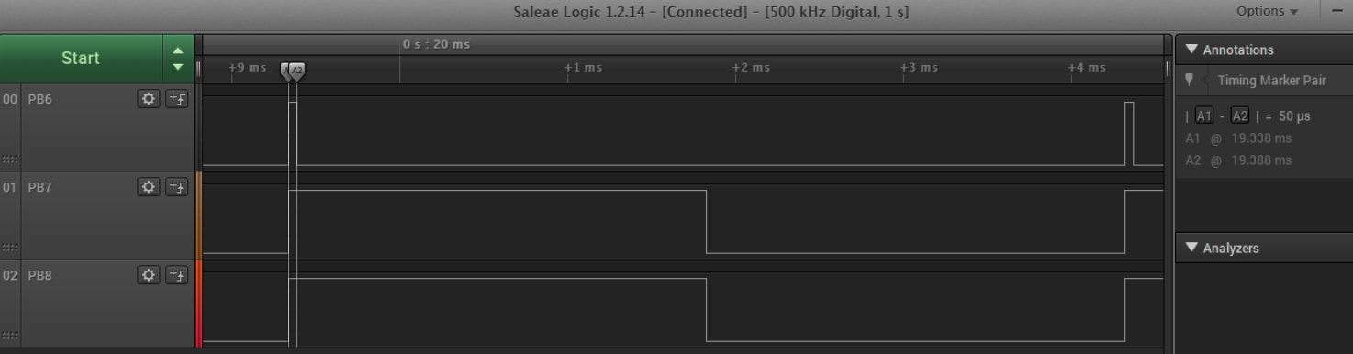
Reduce R down to 1% PWM
Press lower case “r” in order to decrease Red PWM by 1%, repeat.
Verified accuracy of 1% PWM with Logic Analyzer
Notes:
Presently firmware requires a slight pause (Release and re-press key) for best results – This could be refined if desired.

Slide 5
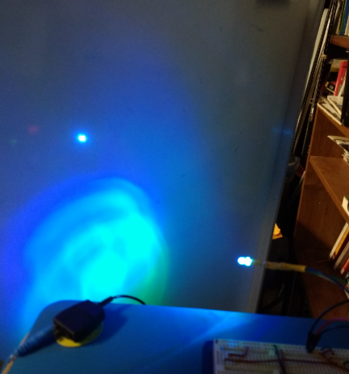
LED output R,G,B = 1,50,50
The Red is not noticeable, only Blue and Green are seen here.

Slide 6
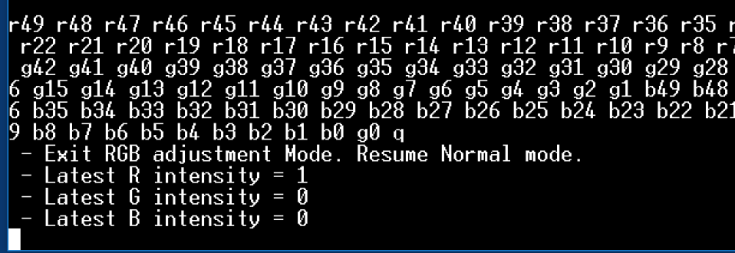
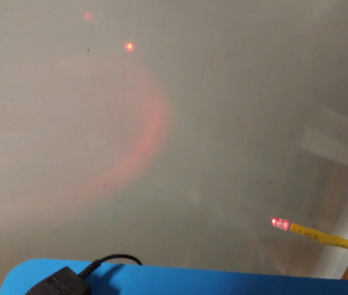
Reduce G and B down to 0 %
At 1% Red only, you can see some faint Red output from the LED.

Slide 7
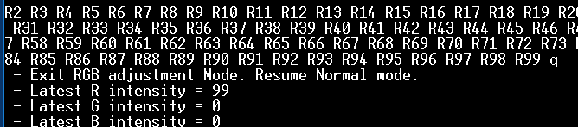
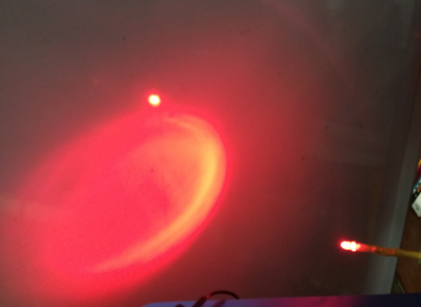
Crank Red up to almost full Power:

Slide 8
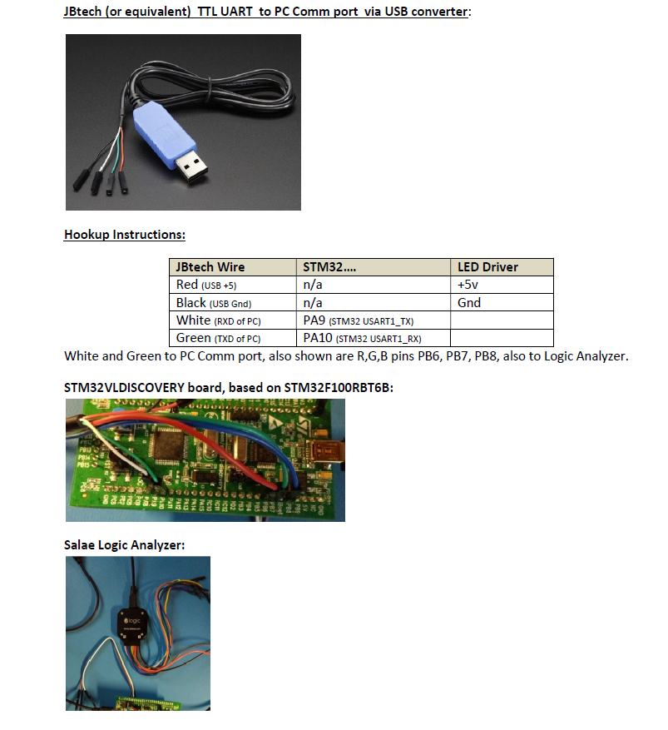
Tools Utilized:

